Slide 1
ORGANISATIONAL
BEHAVIOUR
CHAPTER-17
COMMUNICATION

Slide 2
LEARNING OBJECTIVES
1. Communication is the process of exchanging information and understanding between people.
2. Communication is highly significant as it can destroy or create interpersonal relations.
3. Interpersonal communication comprises such stages as sender, message, encoding, channel, decoding and the receiver.
4. Oral communication, written communication and nonverbal communication are the three types of interpersonal communication.
5. Several barriers make communi-cation ineffective. There are strategies to overcome the barriers.
6. Organizational communication flows horizontally, upward and downward.
7. Communication networks exist in organizations.
8. Informal communication exists along with formal communication.
9. The internet, www, e-mail, voice, mail and telecommunicating represent state of the art information technologies.

Slide 3
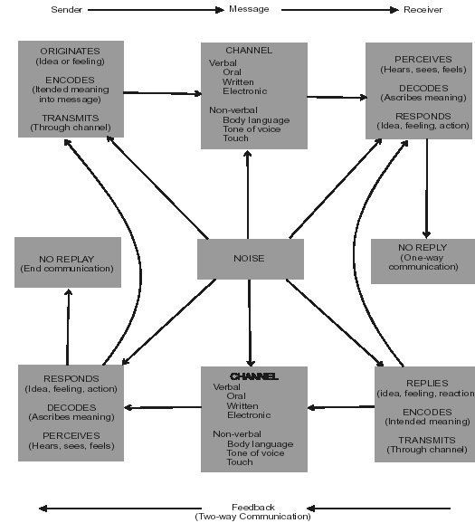
A Model of The Interpersonal Communication Process

Slide 4
EXHIBIT 17-1
Body language
Expression Interpretation
Facial frown Displeasure, unhappiness.
Smile Friendliness, happiness
Raised eyebrows Disbelief, amazement
Narrowed eyes, pursued lips Anger
Eye contact
Glancing Interest
Steady Active listening, interest, seduction
Gestures
Pointing finger Authority, displeasure, lecturing
Folded arms Not open to change, preparing to speak
Arms to side Open to suggestions, relaxed
Hands uplifted outward Disbelief, puzzlement, uncertainty
Body Postures
Fidgeting, doodling Boredom
Hands on hips Anger, defensiveness
Shrugging shoulders Indifference
Square stance Problem solving, concerned, listening
Fidgeting, biting lips, shifting, jingling money Nervousness
Sitting on edge of chair Listening, great interest
Slouching in chair Boredom, lack of interest

Slide 5
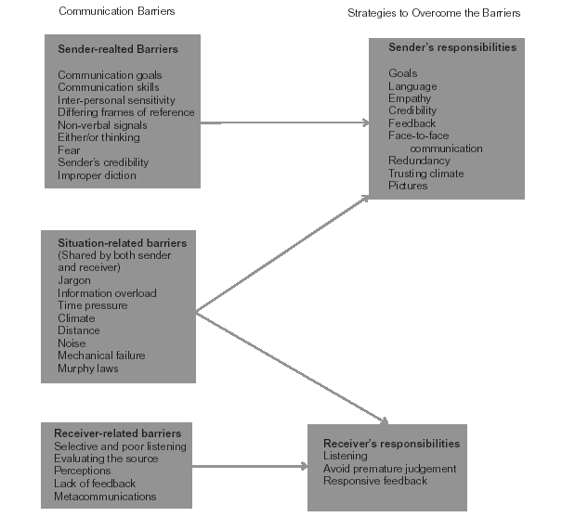
Communication Barriers

Slide 6
Principles of Effective Listening
Principles Good listener Bad listener
1. Look for areas of Seeks personal enlightenment and/or Turns out dry subjects, narrowly defines
interests information, entertains new topics as what is interesting.
potentially interesting.
2. Overlook errors of Attends to meaning and content, ignores Ignores if delivery is poor, misses
delivery delivery errors while being sensitive to messages because of personal attributes
any message in them. of the communicator.
3. Postpone judgement Avoids quick judgements, waits until Quickly evaluates and passes
comprehension of the core message is judgements, inflexible regarding
complete. contrary messages.
4. Listen for ideas Listens for ideas and themes. Identifies Listens for facts and details
the main points.
5. Take notes Takes careful notes and uses a variety of Takes incomplete note using only one
methods for doing so. system.
6. Be actively Responds frequently with nods, and Passive demeanour, few or no responses,
responsive other responses, shows active body little energy output.
state, works at listening.
7. Resist directions Resists being distracted, longer Easily distracted, focuses on loaded
concentration, span, places loaded words or emotional words, short
in perspective. concentration span.
8. Challenge your mind Uses difficult material to stimulate the Avoids difficult material, does not seek
mind, seeks to enlarge understanding. to broaden knowledge base.
9. Capitalize on mind Uses listening time to summarise and Daydreams with slow speakers,
speed anticipate the message, attends to implicit becomes preoccupied with other
as well as explicit messages. thoughts.
10. Assist and Asks for clarifying information or example, Interrupts, asks trivial questions, makes
encourage the uses reflecting phrases, helps to distracting comments.
speaker rephrase the idea.

Slide 7
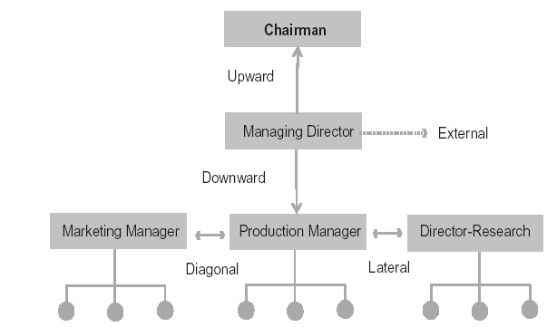
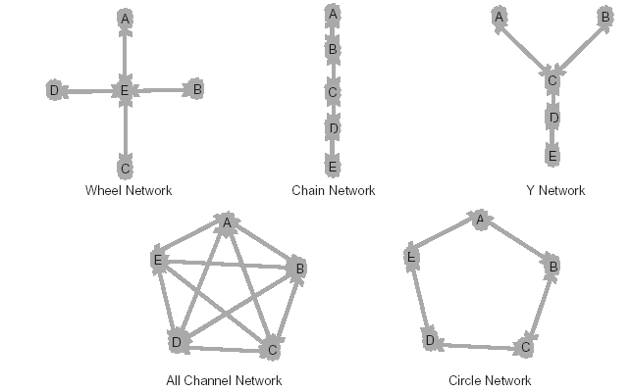
Communication Flows In Organisations
Communication Networks

Slide 8
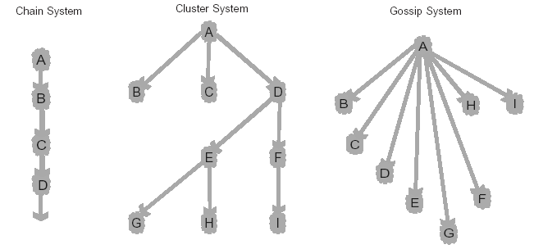
Types of Grapevine Systems

Slide 9
Key Terms
Barriers to communication
Communication media
Downward communication
Information technologies
Knowledge management.
Meta communication
Organizational communication
Upward communication.
Communication
Communication networks
Grapevine
Inter-personal communication
Lateral communication
Non-verbal communication
Rumour

